Slide 1
Avionics components

Slide 2
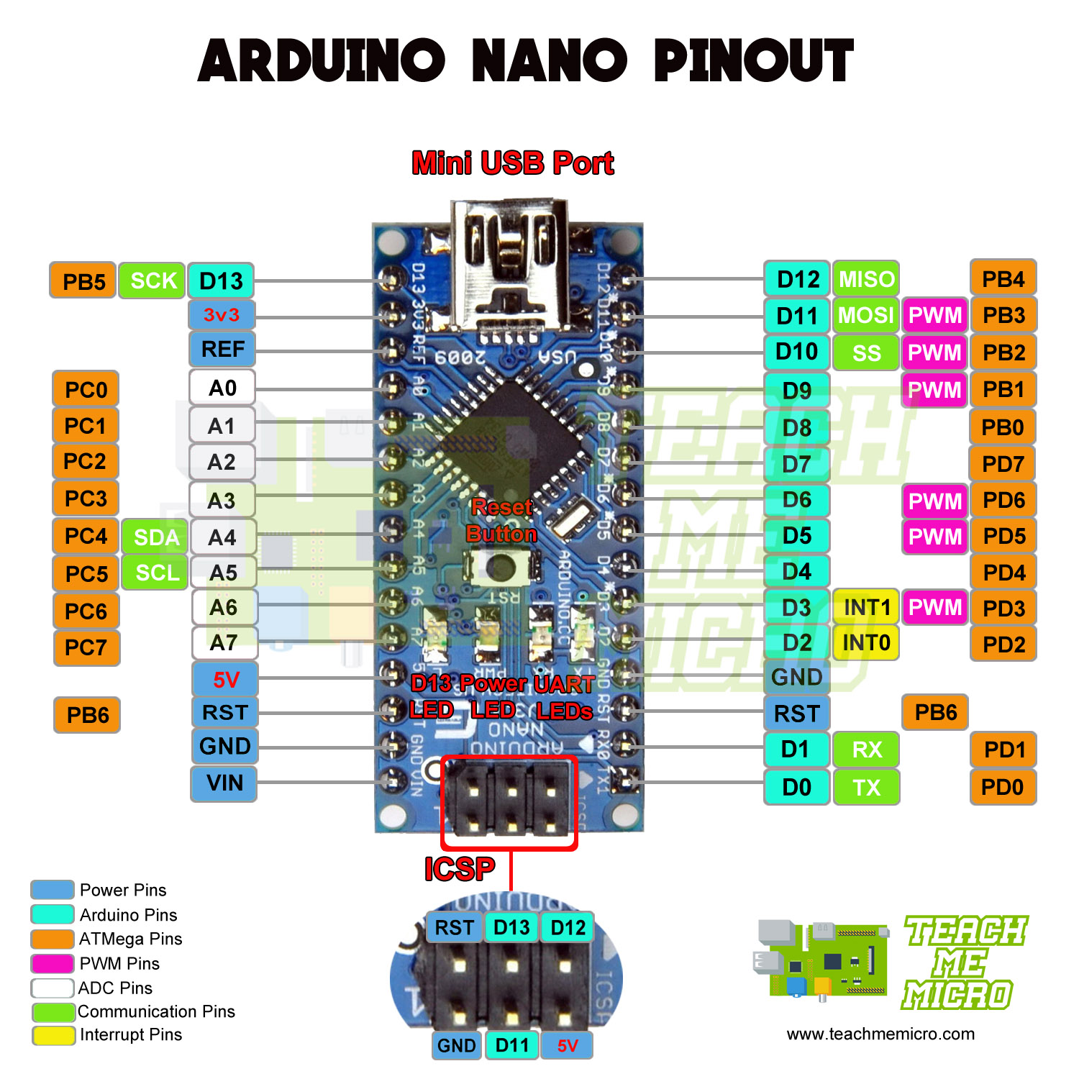

Slide 3
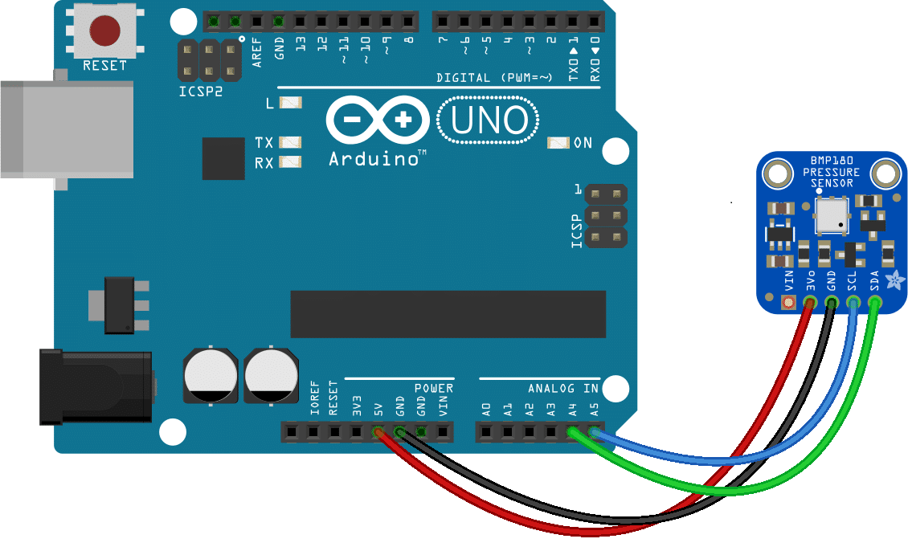
BMP180 PRESSURE, TEMPERATURE SENSOR- 2A0PINS

Slide 4
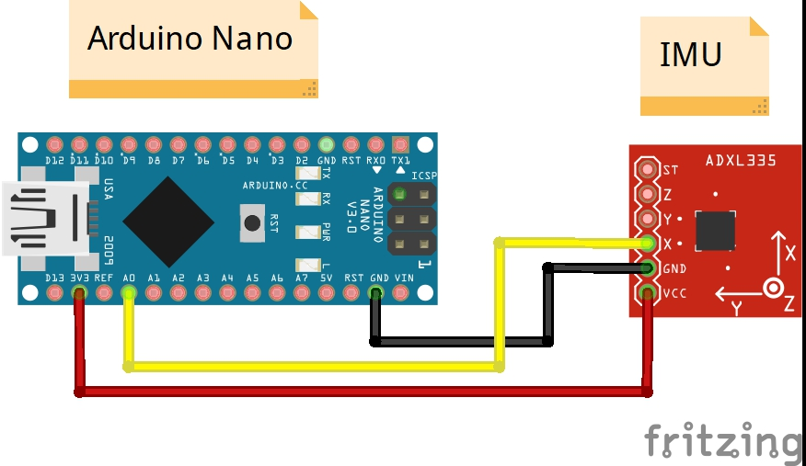
ADXL335- ACCELEROMETER & GYROSCOPE- 3A0

Slide 5
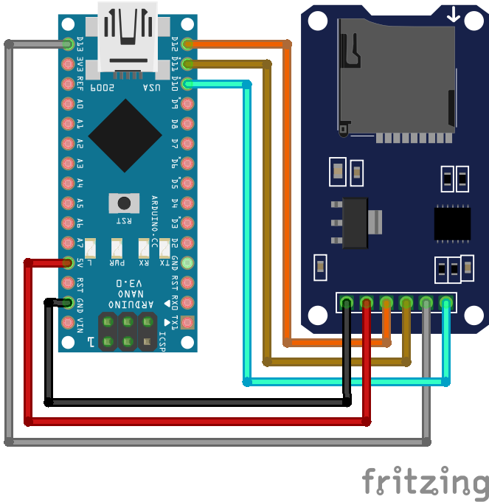
SD CARD CONNECTION WITH ARDUINO NANO- 4D0 PINS

Slide 6
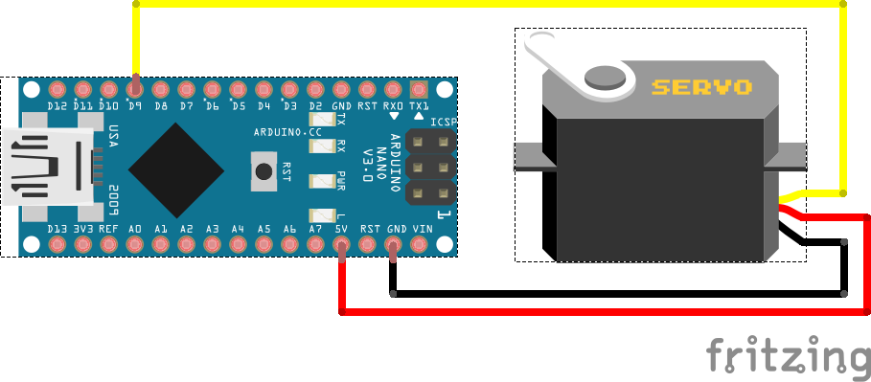
SERVO MOTOR CONNECTION WITH NANO-1A0

Slide 7
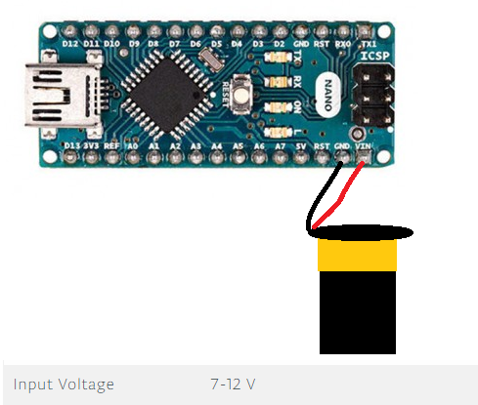
LIPO BATTERY CONNECTION WITH NANO

Slide 8
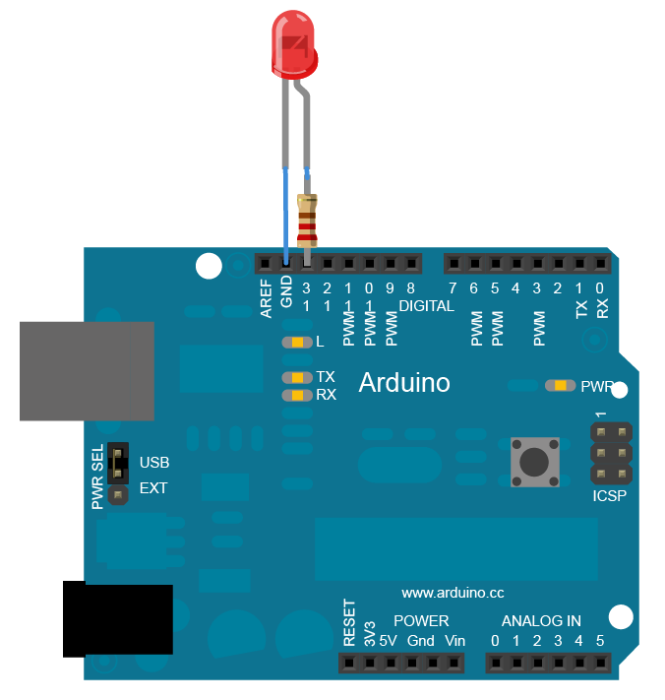
LED INDICATOR- 1D0 pin

